Slide 1
Key Applications for Sensor Data Science: Context-Aware & Persuasive Computing
Youngtae Noh
Notes:
This lecture introduces the concept of context-aware computing.
This slide-deck is based on the paper titled, ‘There is more to Context than Location’

Slide 2



Context-Aware Computing
There is more to Context than Location, Albrecht Schmidt, Michael Beigl and Hans-W. Gellersen, Computers & Graphics Journal 2001
Notes:
This lecture introduces the concept of context-aware computing.
This slide-deck is based on the paper titled, ‘There is more to Context than Location’

Slide 3
Context-aware Computing
What is context?
Acquiring context
Using context info
Errors
Human in the loop
Notes:
In this video, we will review these two first, and the in the following video, we will discuss the later

Slide 4
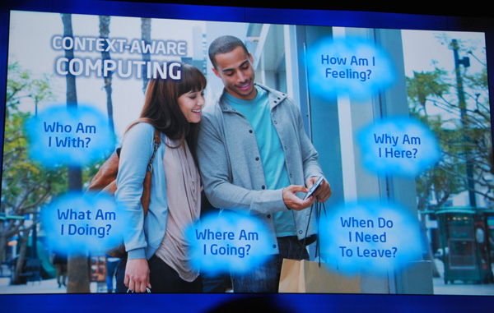
Context-aware Computing
Contextual and Social User Experience
http://images.anandtech.com/reviews/tradeshows/2010/IDF/Day3/DSC_8932.jpg
Notes:
Contextual computing was one of the top 10 technology trend proposed in 2012 by Gartner,
- Gartner is a famous marketing analysis company.
This figure shows various kinds of contextual computing example.
- How am I feeling, why am I her, when do I need to leave, where am I going, what am I doing.
Knowing this kind of contextual information allows application services to provide more intelligent services.
The goal of this lecture is to learn about basics of contextual computing

Slide 5
Context-aware computing
“software that examines and reacts to an individual’s changing context” - Schilit, Adams, & Want (1995)
“.. uses context to provide relevant info and/or services to the user” - Dey (2001)
“…aware of its user’s state and surroundings, and help it adapt its behavior” - Satyanarayanan (2002)
Notes:
Let’s try to understand what contextual computing, or context-aware computing is.
There are several definitions.
#1: software that examines and reacts to an individual’s changing context (that’s the paper that we will discuss in the following lecture)
#2: aware of its user’s stat and surroundings, and help it adapt its behavior.
#3: uses context to provide relevant information and or services to the user.
In general, we can see that context-aware computing requires1) understanding surrounding context and 2) adapting to specific context in order to customized services to the user.

Slide 6
What is context?
“any information that can be used to characterize the situation of an entity” Dey et al., (2001)
Entity: person, place, or object that is relevant to the interaction between a user and an application (including the user and applications themselves)
Who + What + When + Where -> Why?
Understanding and Using Context, Anind K. Dey, Personal and Ubiquitous Computing 2001
Notes:
So then, what is context? That’s the question we’d like to answer.
Dey et al. in 2001 said that any information that can be used to characterize the situation of the entity.
Here the entity would be person, place, and object that are relevant to the interaction between the user and the application.
Knowing “who, what, when, and where” are closely related to why or user intention.
For context-aware computing, learning about these basic characteristics would be really important.

Slide 7
What is context?
Schmidt, Beigl, Gellersen’s model (2001):
A context describes a situation and the environment a device/user is in
A context is identified by a unique name
For each context a set of features is relevant
For each relevant feature a range of values is determined (implicitly or explicitly) by the context
There is more to Context than Location Albrecht Schmidt, Michael Beigl and Hans-W. Gellersen, Computers & Graphics Journal 2001
Notes:
In the paper that we were discussing today, the authors proposed a working model for context.
There are four aspects of context.
#1: a context describes a situation and the environment a device and user currently is in.
#2: a context is identified by a unique name.
#3: For each context a set of features is relevant,
#4: And for each relevant feature a range of values is determined implicitly or explicitly by the context.

Slide 8
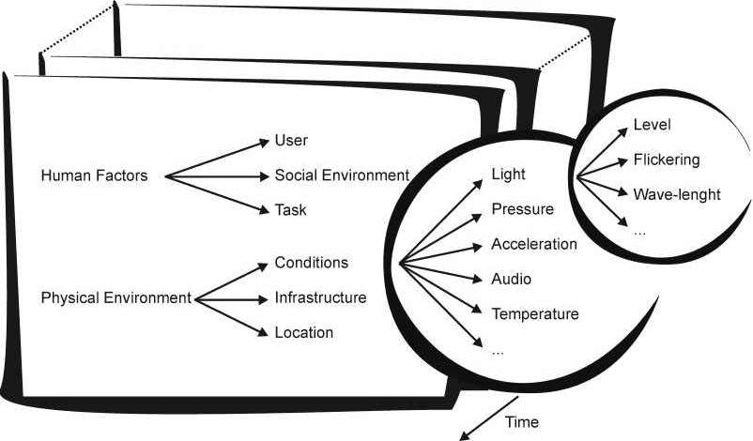
What is context?
Human factors
Information on the user: knowledge of habits, emotional state, bio-physiological conditions
User’s social environment: co-location of others, social interaction, group dynamics
User’s tasks: spontaneous activity, engaged tasks, general goals
Physical environment
Location: absolute position, relative position, co-location
Infrastructure: surrounding resources for computation, communication, task performance
Physical conditions: noise, light, pressure
There is more to Context than Location, Albrecht Schmidt, Michael Beigl and Hans-W. Gellersen, Computers & Graphics Journal 2001
Notes:
This figure shows the overall structure of the context.
The context is divided into two broad concepts.
One is human factor, and the other one is physical environment.
And each of these factors divided into three more categories.
In the case of human factors, it’s divided into user, social environment and task.
#1: What I mean by here the user is information about the user, so the knowledge or habit, emotional state, physiological conditions.
#2: In the case of social environment, it’s simply means whom you are with, the collocated users, and the types of social interaction you’re doing, maybe the group dynamics, the users come and go out of the place.
#3: The task is something that users that are related with user’s task. So, it can be spontaneous activities that users are doing, or something that users are engaged in, or some of the general goals that user are having in their mind.
When we’re saying physical environment, the first thing is condition
#1: that is environment condition like light condition, pressure, or acceleration, noise level,
-- if you further differentiate the light, we can say about the level of the light and circumstances of the lighting
-- for example, whether it’s flickering or not, what are the intensity levels, or what the wave-length of the light is.
#2: in case of infrastructure, we’re saying the surrounding resources for the computation or communication, or task performance.
#3: last but not the least, is location.
>> location can have absolute location, where users are in certain location,
>> or relative position related to certain location, or we can have semantic location, say my office, lecture room that I’m taking this course.
As noted in the paper, overall context describes the situation and environment that users and devices in.
And we’ve shown that context is actually identified by a name and each context has a set of features, here the human factors, user, social environment, task and so on.
And we have physical environment that are condition, infrastructure, and location.
And in the case of condition, environment condition, we have light, pressure, acceleration, audio, temperature and so on.
So, it has a detailed list of features and each feature has certain levels, range of values that are determined by the context.
I would like to tell you that additional context is provided by history, which is changing in the feature space over time
---------------------------------
User: information on the user (knowledge of habits, emotional states, biophysiological conditions, etc.)
Social environment: co-location of others, social interaction, group dynamics
Tasks: spontaneous activity, engaged tasks, general goals, …
Location: absolute/relative position, co-location, ..
Infra: surrounding resources for computation, communication, task performance, etc.
Physical conditions: noise, light, pressure

Slide 9


Beyond Simple Context: SHM
Structural Health Monitoring (SHM) aims to identify damages in systems
SHM Analogy
System
Sensor
Signal
Expert Analysis
Application Domains: Aerospace (e.g., airplanes, helicopters), civil engineering (e.g., buildings, dams, tunnels, bridges, mining), transport (e.g., automotive, trains, ships), energy (e.g., wind turbines, oil/gas installations/pipelines)
Notes:
Digital phenotype means personal digital footprints of biological, behavioral, and environmental data, captured either consciously or unconsciously by smart devices and wearables (Nature Biotechnology, 2015)
※ Extended phenotype means that phenotypes should not be limited just to biological processes (e.g., tissue growth) but extended to include all effects that a gene has on its environment inside or outside of the body of the individual organism (e.g., beaver dam)

Slide 10
Beyond Simple Context: Digital phenotyping/biomarkers
Mobile and wearable devices offer a large personalized, direct, and high frequency sensing potential
Digital biomarkers for Alzheimer’s disease: the mobile/wearable devices opportunity, 2019 Lampros C. Kourtis, Oliver B. Regele, Justin M. Wright & Graham B. Jones npj Digital Medicine 2
Notes:
Digital phenotype means personal digital footprints of biological, behavioral, and environmental data, captured either consciously or unconsciously by smart devices and wearables (Nature Biotechnology, 2015)
※ Extended phenotype means that phenotypes should not be limited just to biological processes (e.g., tissue growth) but extended to include all effects that a gene has on its environment inside or outside of the body of the individual organism (e.g., beaver dam)

Slide 11




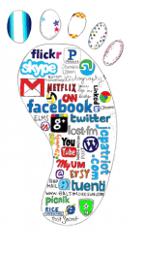





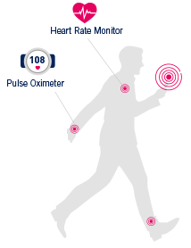


Beyond Simple Context: Digital phenotyping/biomarkers
Digital phenotype means personal digital footprints of biological, behavioral, and environmental data, captured either consciously or unconsciously by smart devices and wearables (Nature Biotechnology, 2015)
Public Data
IoT Devices
Environmental
Behavioral
Smartphones
Biological
Wearables
Intelligent Positive Computing with Mobile, Wearable, and IoT Devices: Literature Review and Research Directions, Uichin Lee Kyungsik Han, Hyunsung Cho, Kyong-Mee Chung, Hwajung Hong, Sung-Ju Lee, Youngtae Noh, Sooyoung Park, John M. Carroll, Ad Hoc Networks Journal (Elsevier), 2019
Notes:
Digital phenotype means personal digital footprints of biological, behavioral, and environmental data, captured either consciously or unconsciously by smart devices and wearables (Nature Biotechnology, 2015)
※ Extended phenotype means that phenotypes should not be limited just to biological processes (e.g., tissue growth) but extended to include all effects that a gene has on its environment inside or outside of the body of the individual organism (e.g., beaver dam)

Slide 12
Acquiring Context
Smart environment:
Infra for obtaining context and for providing context to mobile apps
E.g., active badge system: a badge sensing system that obtains location info
Mobile sensors:
Embedded sensors in smart devices
E.g., digital cameras w/ motion sensors, smartphones w/ light and motion sensors (automatic brightness control, screen rotation)
Notes:
So then, how do you actually acquire context information?
First, we can get contextual information from smart environments:
When we say about smart environment, it is more like internet of the things, smart homes, smart modes in the system.
So they are the infrastructure for obtaining context and for providing context to mobile applications.
A good example will be the active badge system:
-- it’s a badge-based sensing system where users wear badges that periodically send out IR beacon signals.
-- And each room, there is a transceiver that detects a user’s location.
Second, we can get contextual information from mobile sensors
- optical/vision sensors: optical (photodiode, IR, UV), vision: camera
- audio sensor: audio signals
- motion sensor: accelerometer
- location: indoor (room level, fine-grained 3D positioning), outdoor
- biosensors: pulse, skin resistance, blood pressure (sports/medical apps)
- other specialized sensors: touch, temperature, air pressure, etc.
surprising, most smartphones and smartwatches have all these sensors!
And you can program these sensors easily using standard SDKs..
** this is the end of video 1!!

Slide 13
Sensor fusion
Fusion of multiple sensors to infer a user’s context
Example:
Based on statistical analysis of sensor data, specify rules for context recognition
Sensor fusion: sensors => cues (abstracted representation of sensor data: symbolic) => context (can be represented using a set of cues)
(cf. raw sensor data can be also directly used for context learning instead)
Context | Cues
In the office | Artificial light, stationary or walking, room temperature, dry
Jogging | Natural light (cloudy or sunny), walking or running, dry or raining, high pulse
Notes:
Let me briefly tell you about sensor fusion.
- as the name tells, sensor fusion means we use multiple sensors to infer a user’s context.
One very simple approach is the following:
- we perform statistical analysis on sensor data, and based on that analysis, we can specify simple rules for context recognition.
- for example, from raw sensor data, we can extract some cues which is abstract or symbolic representation of sensor data
- then, we can represent a context using a set of cues.
Let’s take a look at this table.
- the context of “in the office” can be defined using a set of sensors:
>> from a light sensor => symbol of “artificial light”
>> from a motion sensor => whether a user is stationary or walking
>> from a temperature sensor => whether it’s room temperature or not..
>> from a humidity sensor => whether it’s dry or humid..
- the context of “jogging” can be defined as follows:
>> from a light sensor => Natural light (cloudy or sunny) vs. artificial light..
>> from a motion sensor => walking or running
>> from a temperature sensor => whether it’s room temperature or not
>> from a pulse sensor => whether a user’s pulse is high or not..
Please note that this is one way of sensor fusion.
You can use many different kinds of machine learning algorithms to make better inferences.

Slide 14
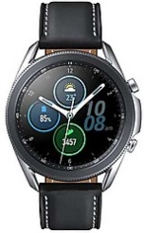

Discussion
Review the definition of context (2 min)
What are the key properties? What are the elements?
Discuss how your mobile phones (or smart watches) can be used for acquiring context information? (3 min)
Accelerometer
Magnetometer (Compass)
Gyroscope
Ambient Light
Proximity
Camera
Voice
Pressure (Barometer)
NFC
Heart Rate
Fingerprint scanner

Slide 15
Categorizing Context-aware Apps
Design dimensions
Info vs. command: whether the task at hand is getting information or doing a command
Manual vs. automatic: whether the task is effected manually or automatically
 | Manual | Automatic
Information | Proximate selection & Contextual information | Automatic contextual reconfiguration
Command | Contextual commands | Context-triggered actions
Notes:
whether the task at hand is getting information or doing a command,
and whether it is effected manually or automatically.
We can broadly classify context-aware applications, by using two dimensions:
* one dimension is whether the task at hand is to get some information or to perform some command.
* another dimension is whether the task at hand is executed manually or automatically.
Let's look at the table.
- If a task at hand is to get information is manually done, we're thinking about the proximate selection and contextual information.
- If a task at hand is to perform a command and it’s manual operation, then it can be considered as contextual commands.
- On the other hand, if the task at hand is to get information and it’s automatically done, we can say that it's more like automatic contextual reconfiguration; for a given piece of information, system components or network connectivity is automatically re-configured.
- And if it is to perform commands and it is automatically done, we can say that it's context-triggered actions. For example, if you enter the room, you download meeting minutes.
We will talk a look at some examples to better understand these categories..

Slide 16
PARCTAB usage scenarios
(room-level localization + wireless net connections + interactive display (128x64pixel)
Notes:
Before we talk about details, let me first illustrate the PARCTAB scenario that was presented in the paper.
PARCTAB is a small hand-held computer with wireless networking capability.
It supports room-level localization + wireless net connections + interactive display (128x64pixel)
#1) On the left hand side, you can see a virtual whiteboard, and people are actually collaborating through the virtual screen
#2) In the middle, people are talking to each other; it looks like they are sharing files
#3) On the right, it looks like he just entered the room, it automatically reconfigure the device, and it also shows some alarm signals on the wall.

Slide 17
Proximate selection
A user interface technique that makes the located objects “emphasized” or “being easier to choose”
Located objects
Computing devices; e.g., display, speakers, thermostats, wifi hotspots
Non-physical objects and services accessed at a particular location; e.g., menus, lists of instructions or regulations
Places that users want to find (like yellow pages); e.g., sorting places according to the distance
Notes:
Let’s first take look at the proximate selection.
In the paper the authors said that what is proximate selection is,
>> it's a user-interface technique that makes the located objects emphasized or being easier to choose.
It would be useful for displaying “located objects” so that users can select what he/she want to use.
* in the case of computer input/output devices, you can browse a list of printers near by you
- when you have the list of printers, you can sort the list based on the distance.
* There could be non-physical objects or virtual objects and services accessed at a particular location.
- You have software menus, or the lists of instructions or regulation, like documents.
* It could be even other information like places that users want to find. In this case, as in yellow pages, we can sort places according to the distance.

Slide 18
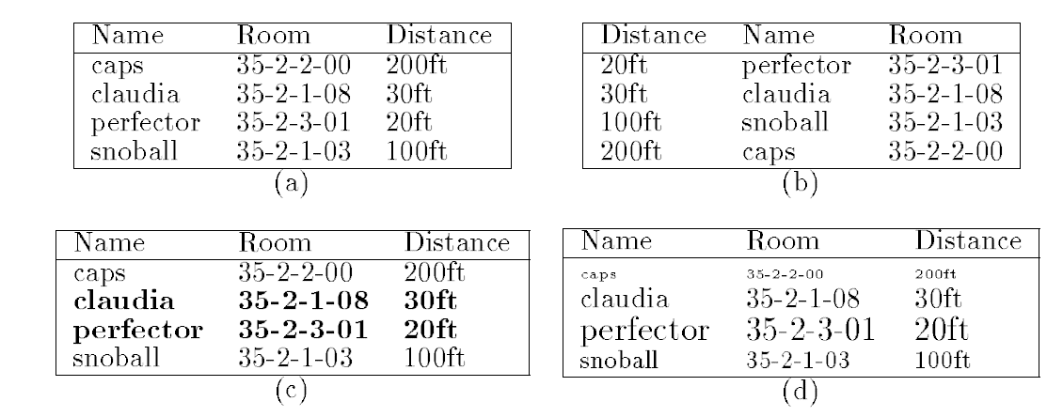
Proximate selection
Proximate selection dialog for printers (name of the printer, location, a distance from the user)
Notes:
Let's take a look at this example for proximate selection.
You scan nearby printers, and you want to provide a proximate selection dialog for printers.
Each printer has three elements: name of the printer, location, a distance from the user.
Here we have four ways of visualizing this information.
#1. In Figure (a), you can see that printer names are alphabetically sorted.
#2. Another option is to order by proximity. That is based on how far each printer is from the user.
#3. The third option is that names are alphabetically sorted, but nearby printers are emphasized with bold characters.
#4. The fourth one shows that names are alphabetically sorted, but distance is visualized based on distance, just like simulating prospective views.
From this example, we can see that by incorporating contextual information, we can think of many different styles for proximate selection.

Slide 19
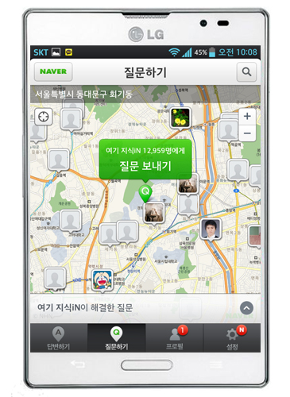
Proximate selection
How about using an interactive map? (virtual objects = questions in Naver KiN “Here”)
Location-based Social Q&A
Notes:
Instead of showing it on a table as before, we can use an interactive map as well.
If we know the current location of users, and the location of other devices, we can visualize the locations of these devices in 2D space.
Let’s take a look at Naver KiN, a location-based social Q&A service.
In this example, you post questions related to your current location, and it will be displayed on the web.
From the map, you can also see the list of questions that are located around you.
By using an interactive map, you can freely navigate different questions by panning and zoom the map.
** this is the end of video 1!!

Slide 20
Contextual info and commands
People’s actions can be predicted by their situations, e.g., library, kitchen, office, etc.
Context parameterizes “context command”; e.g., print – by default: print to the nearest printer
Notes:
Now let's go into the contextual information and commands.
Basically what we can see here is that people's actions are constrained based on where they are located.
If you are in the library, then you're mostly studying, and also if you are in the kitchen, your activities are more like something that you can do in the kitchen.
Similarly, in the office, you are mostly interacting with the computers or reading papers or books.
The key idea here is that context parameterizes context commands as well as the types of information to be used.
-- for example, if you say “print”, by default that printing to the nearest printer.
So whatever the user actions are, they are actually restricted within the environment that the user is located in.
>> then, the set of actions that you can do within the environment can be considered as commands related to the contextual situation.

Slide 21
Contextual info and commands
PARCTAB’s location-based file system
Directories are location names, containing files, programs, and links
Location browser automatically shows the directory that matches with the current location
Office: occupants’ finger plans, calendar files
Lab: general description of the research group
Location browser also runs “contextual commands”
Migrate a remote app’s window to a nearby display
Display a library catalog (when entering the library, this button pops up)
Notes:
Let’s now take a look at PARCTAB’s location-based file system to better illustrate contextual info and commands.
1) Here directories are location names, containing files, programs, and links that can be executed within that location.
2) And there is a location browser that automatically shows the directories that match with the current location.
>> So here, if you're in the office it shows the occupants' finger plans, who are there, what they have been doing, and the calendar files that show whether the room is available or not.
>> And in the lab, it has a file that shows the general description of a research group.
3) Interestingly, the location browser can also run contextual commands like
>> migrating a remote app's windows to a nearby display.
>> Or when you are entering a library, a library category is automatically displayed and you can easily check it out.

Slide 22
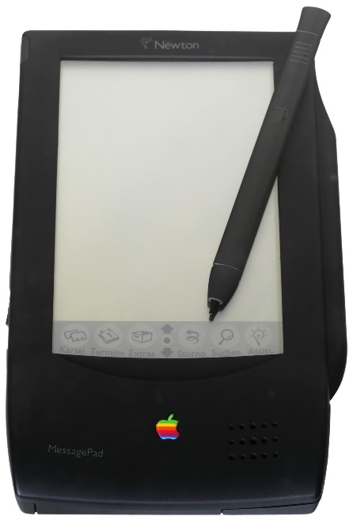
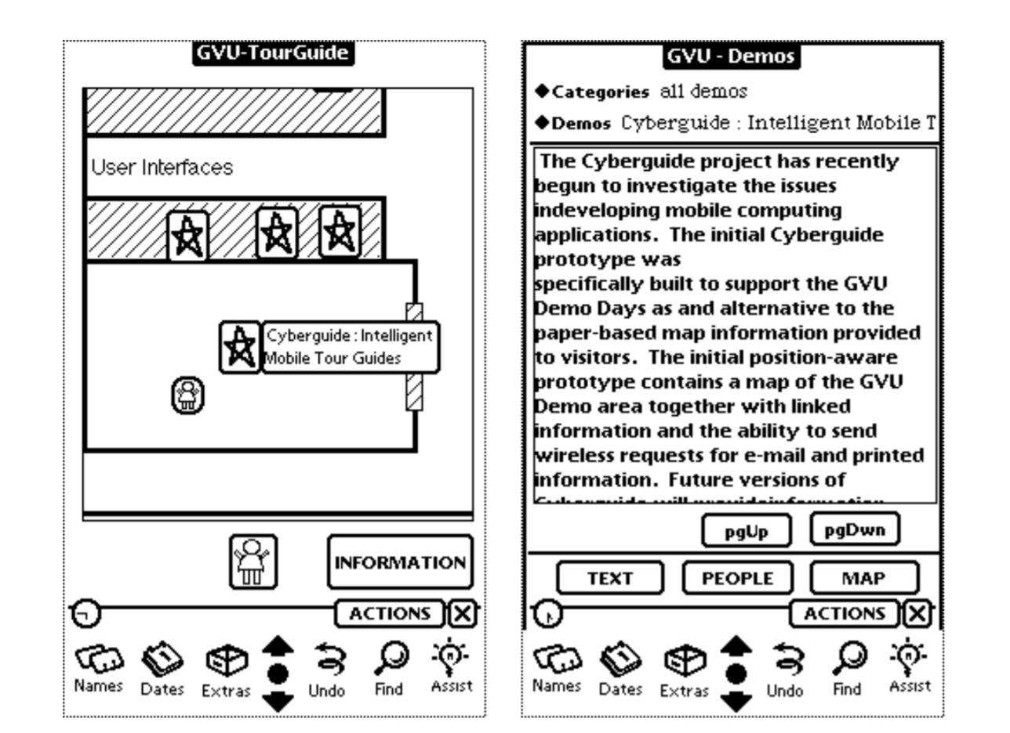
Contextual info and commands
Cyberguide (1997)
Apple MessagePad
Cyberguide: A Mobile Context-Aware Tour Guide, G. D. Abowd et al, Wireless Networks, 1997
'Caches in the Air': Disseminating Tourist Information in the Guide System, 1999
Notes:
Future computing environments will free the user from the constraints of the desktop. Applications for a mobile environment should take advantage of contextual information, such as position, to offer greater services to the user. In this paper, we present the Cyberguide project, in which we are building prototypes of a mobile context-aware tour guide. Knowledge of the user’s current location, as well as a history of past locations, are used to provide more of the kind of services that we come to expect from a real tour guide. We describe the architecture and features of a variety of Cyberguide prototypes developed for indoor and outdoor use on a number of different hand-held platforms. We also discuss the general research issues that have emerged in our context-aware applications development in a mobile environment. in the hands of many students, all with different ideas that they were allowed to investigate
We chose to work initially with the Apple MessagePad 100 with Newton 1.3 and pen-based PCs running Windows for Pen Computing 1.0.
Each platform was available for $150–500 with relatively powerful development environments.
This low cost of hardware was critical to the success of Cyberguide because it made it possible to put a number of units

Slide 23
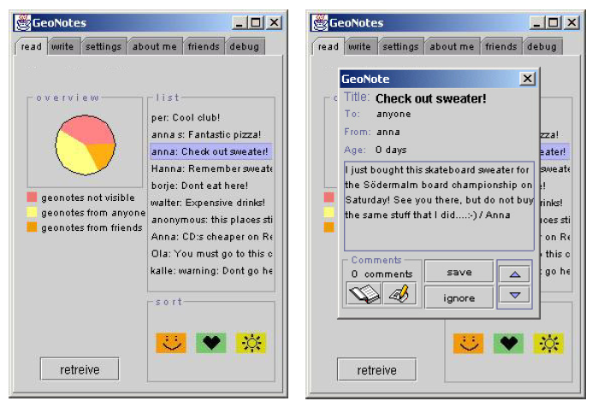
Contextual info and commands
Geonotes (Espinoza et al., 2001)
Real-world annotation (post-it?)
GeoNotes: Social and Navigational Aspects of Location-Based Information Systems, Ubicomp 2001
Notes:
So let's take a look at another example.
In this slide, I show you Geonotes.
This application is more or like an electronic post-it, but it’s a special note that you can “virtually” store information at a certain location.
This paper was published in Ubicom 2001, which is one of the premier conferences regarding this topic.
If you would like to know more about this app, I strongly encourage you to read the paper.
Since it support real-world annotation virtually similar to post-it.
For a given location, it allows you to browse a list of notes posted at that place.
There could be different types of notes such as open notes, private notes from friends.
We can easily see that the information that you’re getting from this is “contextualized information” as it is related to that location.
You can also set filters (e.g., based on sender ID or by keywords, etc.)
> filtering allows users to mitigate the problem of information overload, meaning that there could be too many notes to read by a user.
I just showed you that Geonotes can be considered as a good example of contextual information apps.

Slide 24
Automatic contextual reconfiguration
Process of adding new components, removing existing components, or altering the connection between components
Components and connections: client UI, servers, their communication channels to clients
Changing connections
Changing client/server states (internal + UI)
Notes:
The next concept is automatic contextual reconfiguration.
It’s a process of adding new components, removing existing components, or altering the connection between components.
When we say components and connections, it's a manipulation of client UI, servers, their communication channels to the clients.
For example, changing connections can be like connecting to the virtual whiteboard;
when you’re connecting to this whiteboard, client UI or server’s internal status can be changed.
==
2.2 Automatic Contextual Reconfiguration
Reconfiguration is the process of adding new components, removing existing components. or altering the connections between components. Typical components and connections are servers and their communication channels to clients. However reconfigurable components may also include loadable device drivers, program modules, hardware elements, etc. In the case of context-aware systems, the interesting aspect is how context of use might bring about different system configurations and what these adaptions are. When a group of people is in one place, the people can easily share the physical objects in that place. For example, people in a meeting room share a table that might hold scattered papers, and a whiteboard with diagrams. To promote similar sharing, we wrote a multi-user drawing program for the PARCTAB which provides a workspace for each room, a sort of virtual whiteboard. Entering a room causes an automatic binding between the mobile host and the room’s virtual whiteboard. In this way people in the same room can easily collaborate using the virtual whiteboard. Moving to a different room brings up a different drawing surface. Automatic reconfiguration creates the illusion of accessing this virtual object as if it were physical. Reconfiguration could be based on other information in addition to location, for example, the people present in a room. If a project group is meeting then the project whiteboard is active. This change makes virtual whiteboards more powerful than their physical analogues since a virtual whiteboard can persist from meeting to meeting, and can follow participants from room to room.
Contextual reconfiguration might also include operating system functions: for example, leaving the disk spinning when the mobile has a power connection. Schilit and Duchamp [8] describe how an operating system can use the memory of nearby idle computers for backing store, rather than swapping to a local or remote disk. The context of use, i.e., the hosts in the vicinity, define the system configuration, and when hosts change location, the configuration adapts accordingly. Systems that reconfigure based on context are subject to the same problems faced by reconfigurable systems in general. In addition, if the context is changing rapidly it may be distracting to the user or impractical (due to performance) to adapt to every change. Also, certain adaptions may confuse users, particularly if the context is incorrectly reported, if the user is unaware of what context an application considers relevant, or if the context changes during use. Future work should address these issues.

Slide 25
Automatic contextual reconfiguration
Light sensitive display
Orientation-sensitive user interface
Notes:
Let’s take a look at the examples in the paper.
The first one is a light sensitive display.
>> As I explained earlier, a mobile device’s screen brightness can be intelligently changed based on environmental light condition.
The second one is an orientation-sensitive user interface.
>> So, having orientation sensors, when they flip around devices, they were able to see which direction users are watching, so it automatically flips.
>> Again, this is so easy and so intuitive, but back then this was considered to be a really novel and interesting concept.

Slide 26
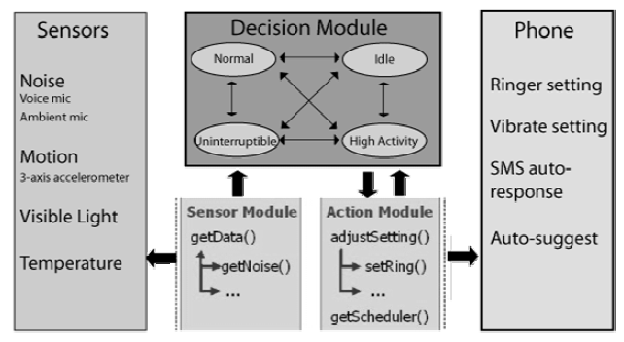
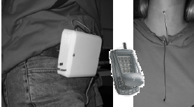
Automatic contextual reconfiguration
Virtual whiteboard example:
When entering a room, a mobile host automatically binds itself to the room’s virtual whiteboard
SenSay (Siewiorek et al., 2003)
A context-aware mobile phone with four states: Uninterruptible, Idle, Active, and Normal (default)
Siewiorek et al., SenSay: a context-aware mobile phone, ISWC 2003
Notes:
Let’s continue our discussion on this virtual whiteboard.
When you enter a room, a mobile host can automatically bind itself to the room's virtual whiteboard.
And then it automatically load you something that you want to share; or can display the content that you discussed earlier with the same group of people.
Let’s take a look at another example, Sensay, which was published in ISWC, International Symposium on Wearable Computers, in 2003.
What happens is that SenSay automatically configures smartphone's status.
It’s called a context-aware mobile phone that has four states: uninterruptible, idle, active and normal states.
Depending on what state the phone is, its actions would be different.
Because this work was published in 2003, smartphones were not really like the current phones back then,
>> so they had costumed hardware
>> for instance, the hardware can detect whether there's noise or not, whether somebody's speaking or not, whether users are moving or not, and whether there are visible lights or not, and what the temperature is.
The system can utilize this sensor data as well as user’s calendar to make automatic actions.
Now, when the calendar says a user is engaged in a meeting, and he’s currently speaking, then the system automatically changes its status to uninterruptable mode.
It is also possible that when a phone call comes in, it can automatically respond back by texting 'oh I'm busy and I can't receive the phone call'.
When the user is actively moving, and ambient noise is high, then the user in the active mode, we can define other automatic configuration and context-triggered actions.

Slide 27
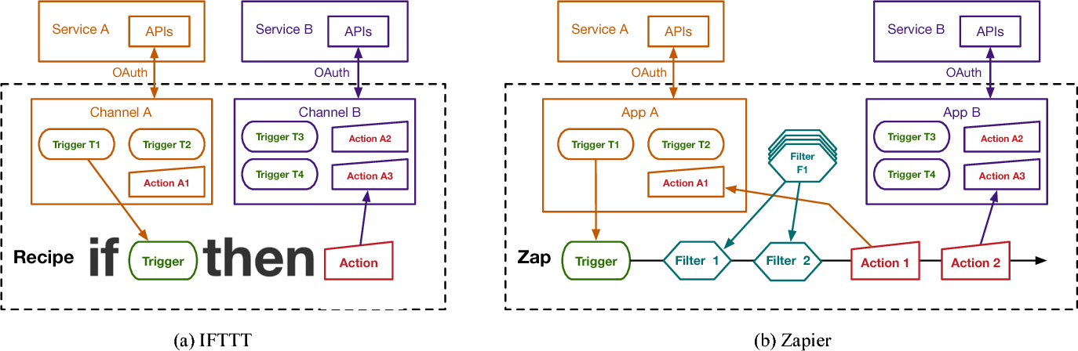
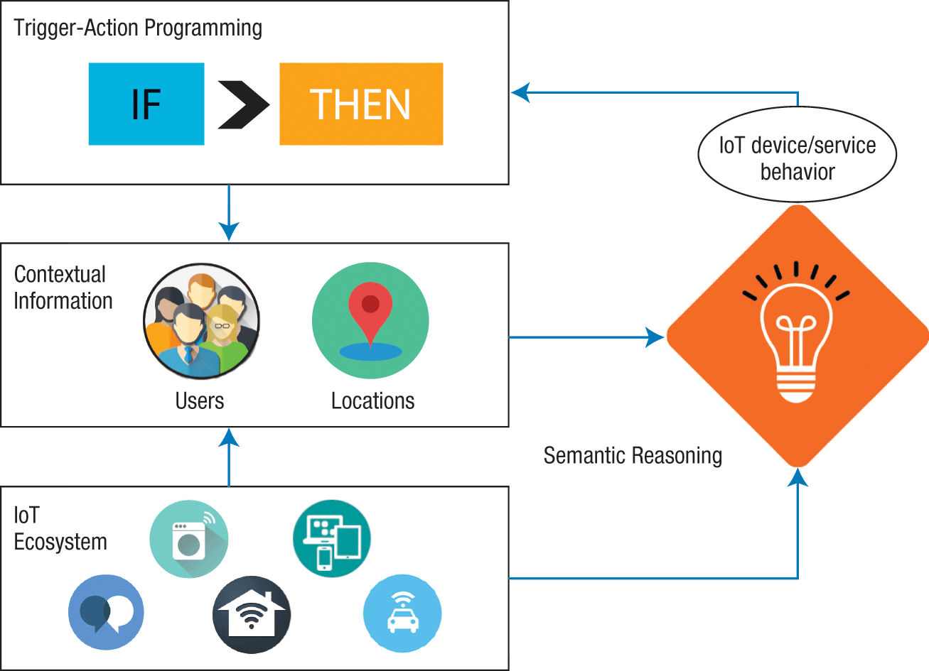
Context-triggered actions
Simple condition-action rules invoked automatically
Challenges:
Expressiveness of language for rules
Context sensing accuracy used in the condition/action
IFTTT – simple if – this – then – that rule
Supporting mental model accuracy in trigger-action programming, Ubicomp 2015
A Semantic Web Approach to Simplifying Trigger-Action Programming in the IoT, Computer 2017
Notes:
Now Sensay brought us to the concept called context-triggered actions.
When we actually talk about context-triggered actions,
it is something like when the context are in a certain condition there are some actions that are invoked automatically.
Here the challenge is mostly about 1) expressiveness of the language for rules and 2) accuracy of the contextual information.
What I here mean by expressiveness of the rules is that how completely you can specify the rules.
Another aspect is even though the rules are expressive enough, another concern is accuracy of contextual information.
So what if it fails to correctly infer contextual information?
And when it makes some mistakes, it automatically trigger certain actions
>> However, if that action may not be good, problems may arise.
>> one way of mitigating this problem is to put human in the loop, by explicitly asking users to confirm inferred context information.
In any cases, system designers should be careful about these two aspects.

Slide 28
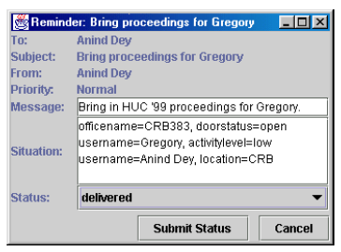
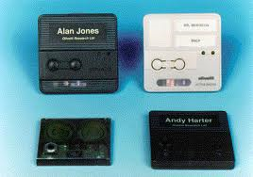
Context-triggered actions
Active Badge:
Rule form: badgeID location event-type action
if I go walk by kitchen, remind me to get coffee (e.g., playing a music) – similar to IFTTT
Active Badge
CyberReminder (Dey et al., 2000)
Notes:
Let me talk about a simple example of the context-triggered actions using Active Badges.
Active Badges are tools that tell you where you're located at.
So we can have a rule, very simple rule, based on {Badge ID, location, event type, action}.
For instance, if I walk into a kitchen, and say, remind me of a cup of coffee:
- my badge, location: kitchen, event type: arriving, action: reminding via a display
Or maybe if I enter the kitchen, you can program it to play your favorite music.
In the first floor toilet, there’s a music player that detects whether a person is entering, and automatically plays a music

Slide 29
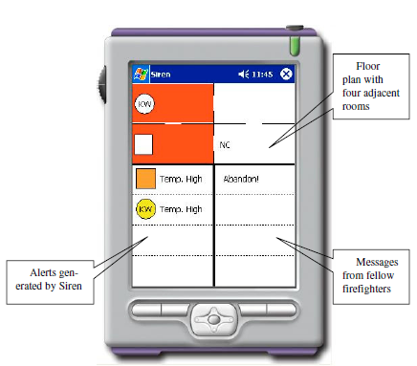
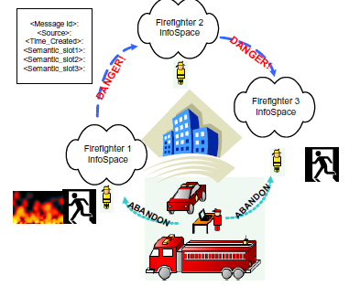
Context-triggered actions
Example: Siren (Jiang et al., 2004)
IF (firefighter F1 IN room A) AND
(surrounding temperature > 1500F)
THEN (generate_alert(firefighter F1 in danger)) AND
(generate_alert(room A is a dangerous place))
Siren: Context-aware Computing for Firefighting, Pervasive Computing 2004
Notes:
The last item we have is more complicated example called Siren which is published in Pervasive Computing at 2004.
We have a group of firefighters here.
These firefighters share the contextual information with other people.
Here, they have some rules, predefined, saying that if certain context configuration is correct, then it allows users to do something.
Let’s take a look at a rule example:
Firefighter F1 is in room A, and surrounding temperature is greater than 1500F, the system generates an alert that firefighter F1 is in danger, and generate an alert that room A is a dangerous place.
Using Siren, we can easily do generic programming like this, and then we can program c.ontext-triggered actions more freely

Slide 30
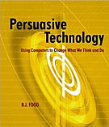
Persuasive Computing
Persuasive Technology: Using Computers to Change What We Think and Do, B.J. Fogg, 2002
Persuasive computers: perspectives and research directions, BJ Fogg, CHI 1998

Slide 31
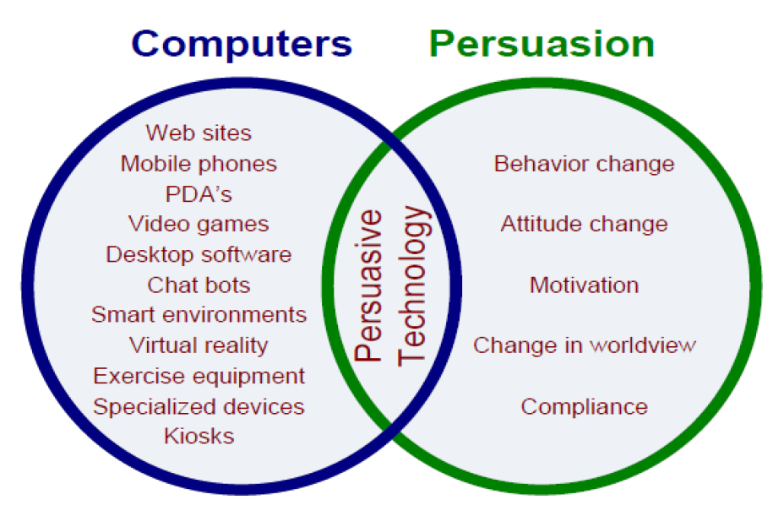
Persuasive Technology
"Simply put, a persuasive computer is an interactive technology that changes a person's attitudes or behaviors or both.“ (B.J. Fogg)
Persuasion is "an attempt to shape, reinforce, or change behaviors, feelings, or thoughts about an issue, object, or action”
Notes:
(endogeneous intent) Captology focuses on endogenous intent, that is, the persuasive intent that is designed into a computing product.
(exogenous intent) A product also could acquire exogenous persuasive intent from users or another source—that is, if a product is adopted for a persuasive goal the designers hadn’t planned. For example, the Palm computer is not a persuasive product by design, but a student might buy it to motivate herself to do homework more regularly. The Sony CD Discman wasn’t designed to be persuasive, but a friend of mine bought one because she thought that the ability to listen to music during her workouts would motivate her to run more often. Captology does not focus on such exogenous intent but only on the endogenous persuasive intent built into a product.

Slide 32
Persuasive Technology
Attitude or behavior change resulting from human-computer interaction (HCI)
Planned persuasive effects of technology, not on side effects.
Endogenous, or “built-in,” persuasive intent, not on exogenous intent.
Notes:
(endogeneous intent) Captology focuses on endogenous intent, that is, the persuasive intent that is designed into a computing product.
(exogenous intent) A product also could acquire exogenous persuasive intent from users or another source—that is, if a product is adopted for a persuasive goal the designers hadn’t planned. For example, the Palm computer is not a persuasive product by design, but a student might buy it to motivate herself to do homework more regularly. The Sony CD Discman wasn’t designed to be persuasive, but a friend of mine bought one because she thought that the ability to listen to music during her workouts would motivate her to run more often. Captology does not focus on such exogenous intent but only on the endogenous persuasive intent built into a product.

Slide 33
Advantages over Human Persuaders
Be more persistent than human beings
Offer greater anonymity
Manage huge volumes of data (store/access/process)
Use many modalities (data, graphics, audio/video, simulation) to influence
Scale easily
Go where humans cannot go or may not be welcome (ubiquitous computing!)

Slide 34
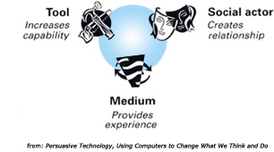
Functional triads of persuasive tech
(role just like “living” entities)
A tool can be persuasive by
Making target behavior easier to do
Leading people through a process
Performing calculations or measurements that motivate
A social actor can be persuasive by
Rewarding people with positive feedback
Modeling a target behavior or attitude
Providing social support
A medium for simulated experiences can be persuasive by
Providing people with vicarious experiences that motivate
Helping people rehearse a behavior (simulating environment or objects)
Allowing people to explore cause-and-effect relationships

Slide 35
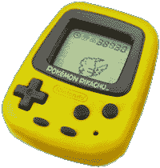
Nintendo’s Pocket Pikachu
Pedometer + Virtual Pet (Pikachu)
Feeding requires “physical movements”
Making users to move more! (walk, run, jump)
Tool – Automatic step counting
Medium – Not clear
Social Actor – Pocket Pikachu (virtual pet)
Notes:
Like other digital pets, Pikachu required care and feeding, but with a twist: the device contained a pedometer that could register and record the owner’s movements.
For the digital creature to thrive, its owner had to be physically active on a consistent basis. The owner had to walk, run, or jump—anything to activate the pedometer.

Slide 36
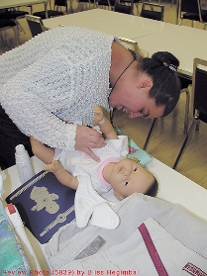
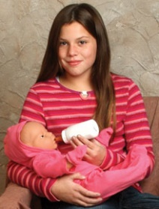
“Baby Think it Over” Infant Simulator
Helps teenage girls understand how much attention a baby requires
Used as part of many school programs
Tool – Tracking user behaviors
Medium – Simulating real-world contexts (i.e., baby caring)
Social Actor – Robot as a real baby to care
Notes:
Like other digital pets, Pikachu required care and feeding, but with a twist: the device contained a pedometer that could register and record the owner’s movements.
For the digital creature to thrive, its owner had to be physically active on a consistent basis. The owner had to walk, run, or jump—anything to activate the pedometer.

Slide 37
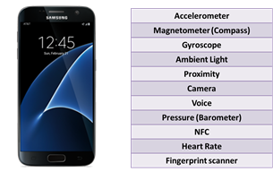
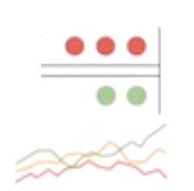

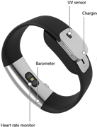
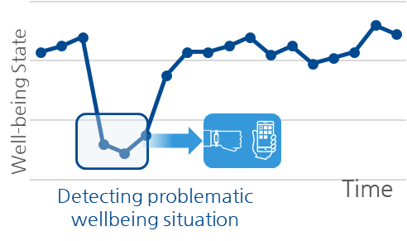
Data-driven In-Situ Intervention
Sense Mobile/Wearable Sensor Data
Analyze & Learn Data Processing & Machine Learning
Inform & Act Data-driven In-situ Intervention
“You reached your daily goal!”
“If you don’t feel good ow, please do this exercise”
Personalized just-in-time intervention
(e.g., Ginger.io)

Slide 38


Discussion
Select one “persuasive” (+contextual) computing service
You can choose any service that you know of
Pick a service/app/product that has some interesting points to discuss (from the perspective of “functional triads”)
Analyze: context sensing + functional triads
What kinds of context sensing does it offer?
How is it related to each of functional triads?
“Persuasive” computing service
Functional triads

Slide 39

Errors
When the system does the wrong thing
Automatically locking car doors
Screen saver during presentation
Microphone amplifying a whisper
False positives vs. false negatives
Application requirement dependent: e.g., machine fault detection (false negative must be minimized)
Whose fault: System vs. User?
How to get over such errors?
Notes:
Let me discuss errors in context-aware computing.
We discussed that the key of context-aware computing is sensing a user’s context, and adapting to that context.
However, if the system makes an error in inferring a user’s context, what happens?
>> For instance, automatically locking car doors
>> when you’re giving a presentation, screen saver can take away your slides.
>> you forgot that you’re wearing a microphone, and it accidently amplified your whisper.
In these examples, you should think of whether they are system’s fault, or a user’s fault.
I think that it’s both.
In any case, system designers should think carefully about ERRORS when designing the system.

Slide 40
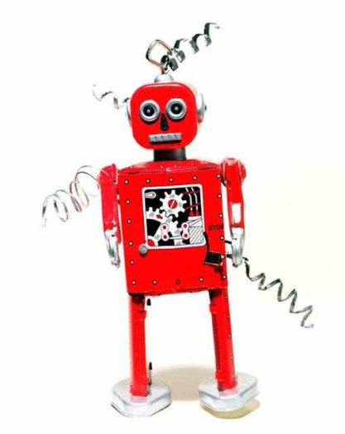
Human in the loop
Context data must be coupled with the ability to interpret it, but computers are bad at common sense
Having more rules makes the system more complicated; doesn’t solve the fundamental problem
Human in the loop
Computers can detect, aggregate, and portray information
Allow human users to interpret and act on it
Human-AI interaction: query, machine feedback, interpretability
Dellermann et al., (2019) The Future of Human-AI Collaboration: A Taxonomy of Design Knowledge for Hybrid Intelligence Systems. HICSS
Notes:
Here, I like to highlight the fact that “human-in-the-loop” is a powerful approach of dealing with errors (or inaccuracy of context inference).
Context data mush be coupled with the ability to interpret it, but computers are bad at common sense.
What is so straightforward to the users is not so straightforward to the computers.
We can simply say that we can configure more and more rules, but the thing is that having more rules makes the system more complicated
It really doesn’t solve the fundamental problem.
In this case, we can use the principle of human in the loop system design.
-- we know that computers are good at quickly gather data, and detect/aggregate/portray information.
-- so then computers can give selected set of information to the user and ask human users to interpret it.
>> In the case of city tour guides, a system can detect a user’s location. But it may fail to get accurate position;
>> the system can have some option buttons, by saying “If this is not your current location, you can search for your location”
Anything that could be easily done by human, but it’s fairly difficult and inaccurate,
you can use human-in-the-loop as long as it’s not that laborious!

Slide 41
Summary
What is context?
Acquiring context
Using context info
Proximate selection: Nearby printer selection
Contextual information and commands: GeoNotes, Map-based info
Automatic contextual reconfiguration: Virtual Whiteboard, SenSay
Context-triggered actions: Active Badge, Siren
Persuasive Technology aims to change a person's attitudes or behaviors or both
Functional triads: (1) tool (increase capability), (2) medium (provide experience), (3) social actor (creates relationship)
Errors
Human in the loop
Notes:
To summarize, in this video lecture, we learned that what is context.
1) We learned that there are a variety of definitions about the context
>> We discussed that theirs is more to Context than Location
>> Context can be broadly classified the human factors and physical environment.
* And human factors have users, social environment and task.
* And physical environment is environment conditions, infrastructure available around users, and also the location of the users, location could GPS like position, could be semantic information like which location you’re in like coffee shop or in the office.
2) The second thing is how to acquire contextual information.
>> We talked about two things.
A) One source is a smart environment assuming that you have sensors available, and also the wireless communication available, or wired communication with that devices.
B) Another source is the mobile devices. There could be many embedded sensors in your smart devices. Recent smartphones have a motion sensors, light sensors, and temperature sensors, and pressure sensors and so on.
3) The use of context information, it can be used to adapt mobile device itself, but it can be used for orchestrating other services as well.
So, we talked about three representing example, 1) adapting user interfaces, 2) providing context or communication services, and 3) proactive application scheduling based on the context.
4) And we then talked about what happens when errors happen.
>> in some cases, computers are not really good at understanding what may be straightforward to the users.
>> So, we have to think about how to actually cope with errors.
5) And as an alternative method, I talked about human in the loop system design.
Instead of making more and more rules, what we can do is that allow human interpret the results and act on it
adaptively learning this kind of human helps can make the system more intelligent as time passes

